Slide 1
Non-invasive diagnosis of liver fibrosis
GHIF
June 16th 2018
Vlad Ratziu, Sorbonne Université, Hôpital Pitié Salpêtrière,
Paris, France

Slide 2
Amount of liver fat ?

Slide 3
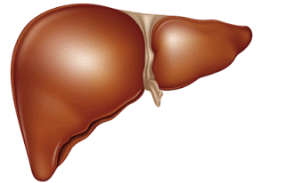
NASH is associated with more severe hepatic and systemic disease
More
Profound
IR
Higher ALT
More
Marked
CV lesions
NASH
(vs.steatosis)
More advanced fibrosis
More severe
Metabolic
comorbidities

Slide 4
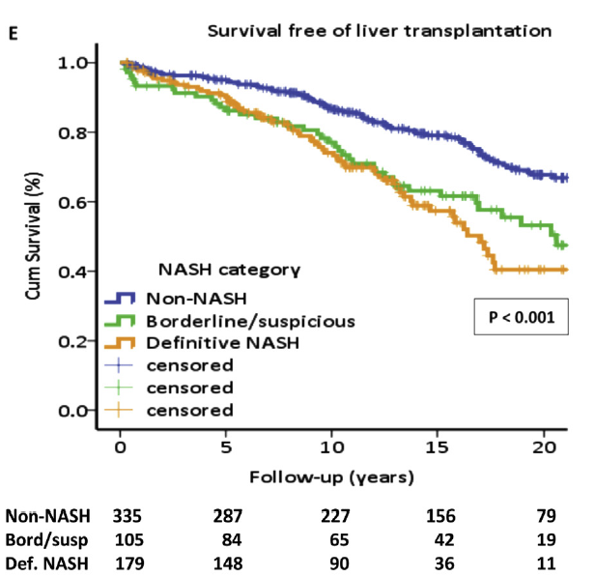
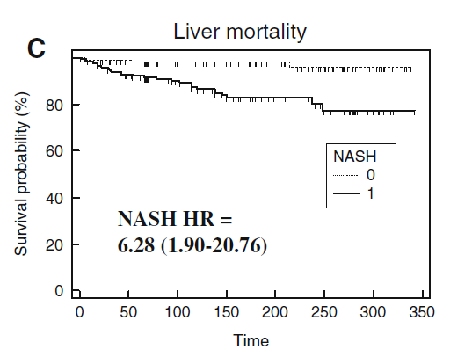
NASH increases liver-related mortality
Cumulative LRM according to PRESENCE OF NASH on index liver biopsy
Liver Related Mortality
NASH patients have higher risk of liver mortality than non NASH
Matteoni CA, Younossi ZM, Gramlich T, Gastroenterology. 1999 Ekstedt M, Hagström H, Nasr P, et al. Hepatology 2014
Younossi ZM, Stepanova M, Rafiq N, et al.. Hepatology 2011
Stepanova M, Rafiq N, Makhlouf H et al. Dig Dis Sci 2013
Notes:
the 2 lesions that are clinically and prognostically relevant are stage of fibrosis and presence of NASH. Indeed, this study from Dr Younossi group clearly confirmed that LRM is significantly increased in patients with septal fibrosis (F3) and cirrhosis (F4) independently of other criteria. Similarly patients with NASH display significantly increased LRM in their follow-up according to those who have not.
Because both accurate staging of fibrosis and diagnosis of NASH rely on histology, the logical question that arise is

Slide 5
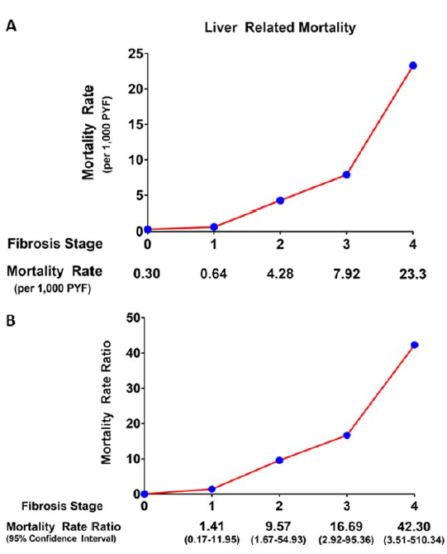
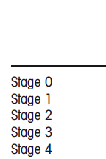
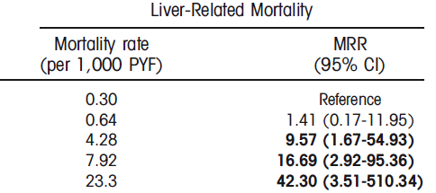
Fibrosis stage-specific liver-related mortality
5 studies with histologically documented NAFLD
1495 pts ; 17,452 yrs. of f/up
Stages 0/1/2/3/4: 38%/29/14/12/7.4%
Dulai, Hepatology 2017

Slide 6
Causes of Cirrhosis (US)
Multiethnic Cohort, Medical Claims, Medicare claims 1999-2012
NAFLD
10%
NAFLD
29%
ALD
HCV
Crypto
HBV
Other
Setiawan, Hepatology 2016

Slide 7
Current view of candidates for pharmacotherapy – 1: non cirrhotic NASH
No/mild fibrosis F0,F1
NAFL
NASH
High risk of
Progression
NASH
Significant
fibrosis (F2)
Advanced
fibrosis (F3)
NASH
Cirrhosis

Slide 8
Regulatory Pathway for Late Stage RCTs in NASH
Fibrogenesis
IR/Lipotoxicity
AT Dysfunction
NASH
CIRRHOSIS
ESLD
Systemic Inflammation
Surrogate
Reasonably Likely
Surrogate
Generally Accepted
Hard Clinical
Outcomes
Currently Recommended Outcomes for Registrational Trials
Resolution of NASH
>1 stage reduction
in fibrosis
Death &
cirrhosis
complications
Progression
to cirrhosis
Conditional Approval
Definitive Approval

Slide 9
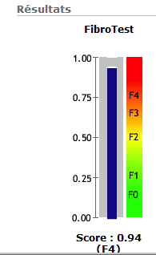
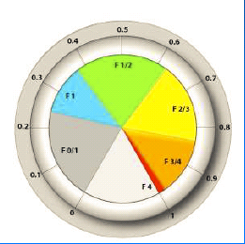
Serum Fibrosis markers
FREE OF CHARGE
COMMERCIAL
NFS (NAFLD Fibrosis Score)
Age, glucose, BMI, Plt, Alb, AST/ALT
FIBROSURE
(Age, sex, α2macrog, haptoglobin, ApoA1, Bili, GGT
FIB4
Age, ALT, AST, Plt
Hepascore
Age, sex, α2macrog, Hyal ac, GGT, Bili
ELF
(Age, Hyal ac, TIMP1, P3NP
BARD
(BMI, AST/ALT, DM)
FIBROMETER
(Age, Plt, PT, AST, urea, α2macrog, Hyal ac
APRI
AST/Plt

Slide 10
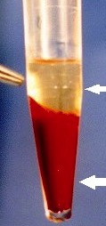
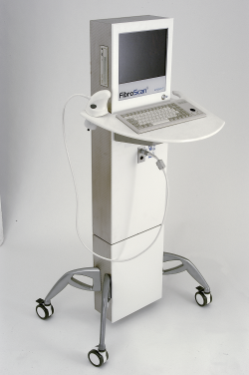
Summary: significant fibrosis
=
Serum markers
Transient elastography
Courtesy L Castera

Slide 11
Summary: cirrhosis
<
Serum markers
Transient elastography
Courtesy L Castera

Slide 12
Fibroscan M or XL ?
M
XL
Failure
10-16%
1-2%
Unreliable
33-50%
25%
1.7 Kpa (+/-2.3) lower for XL
Similar diagnostic performance
M
XL
F 2
7
6.2
F 3
8.7
7.2
F4
10.3
7.9
Wong, Am J Gastro 2012
XL probe second line if M fails ?
Myers, Hepatology 2012
Notes:
In a series of patients BMI >28 both HCV or NAFLD
XL second line if M fails (30 % in overweight NASH)

Slide 13
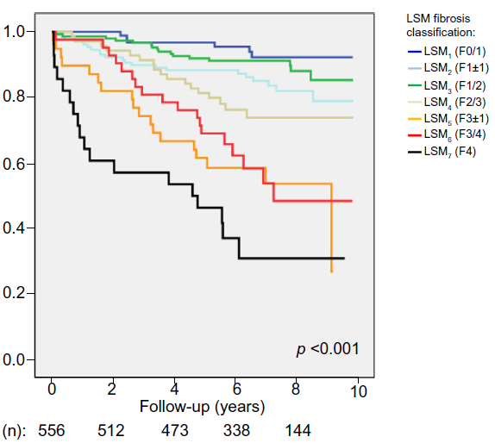
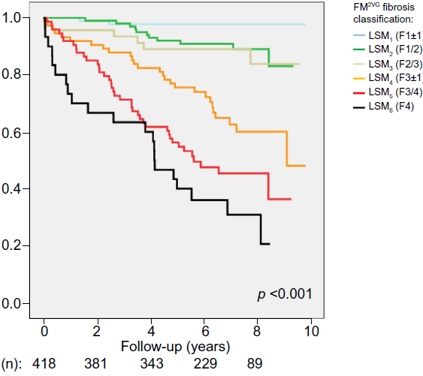
Prognostic value of non-invasive markers in NAFLD
Boursier, J Hepatol 2016

Slide 14
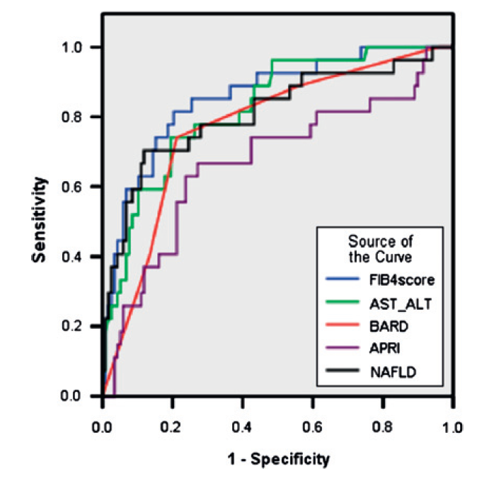
Staging fibrosis with NFS, FIB-4, and others …
High (>92%) NPV for advanced fibrosis
Useful in clinical practice for excluding advanced fibrosis
ELF performed only marginally better than NFS
Modest PPV – liver biopsy still neessary
McPherson, Gut 2010
Guha, Hepatology 2008

Slide 15
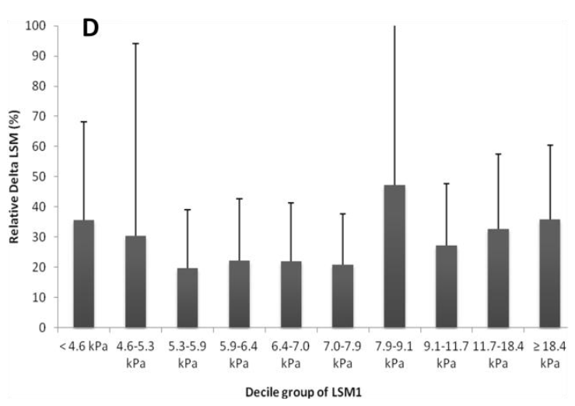
Short-term variability of elastometry measurements
531 paired liver stiffness measurements in 432 patients
> 1 day and <1 year apart
Nascimbeni F, Clin Gastro Hepatol 2015

Slide 16
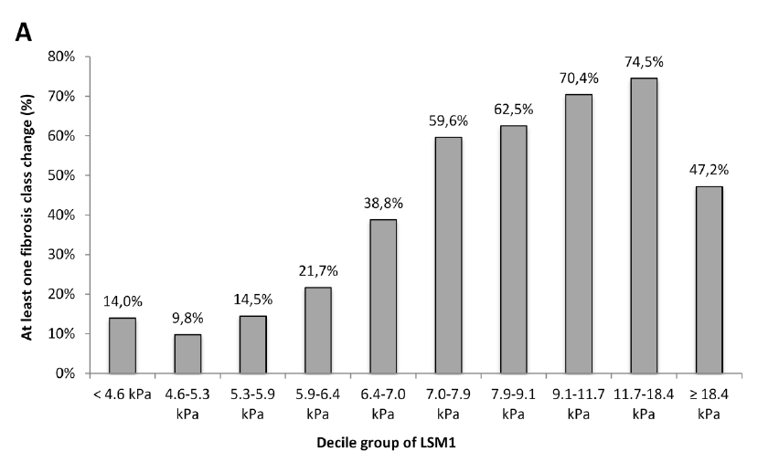
Short-term variability of elastometry measurements
531 paired liver stiffness measurements in 432 patients
> 1 day and <1 year apart
6.5-7 kPa
Nascimbeni F, Clin Gastro Hepatol 2015

Slide 17
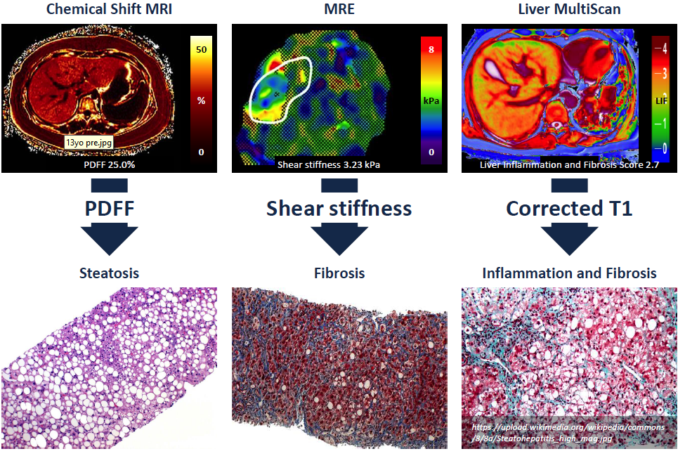

Slide 19
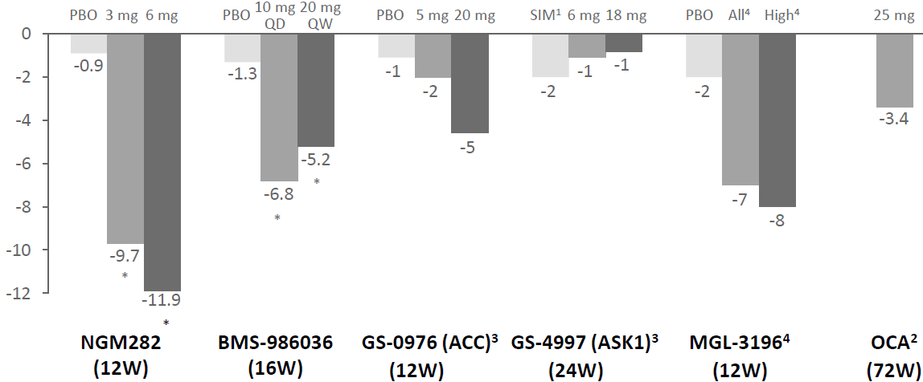
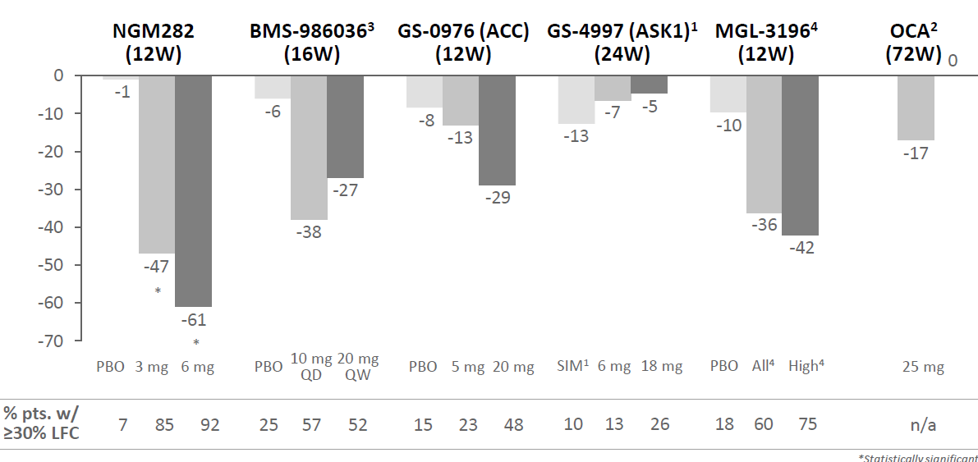
Changes in absolute liver fat content
Changes in relative liver fat content

Slide 21
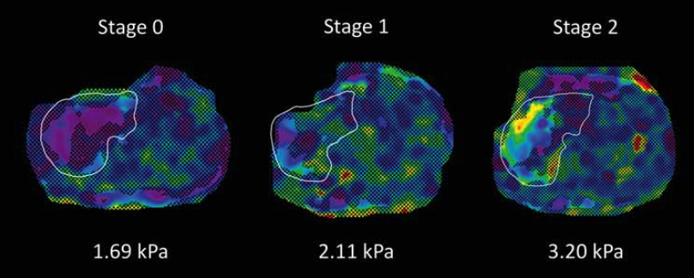
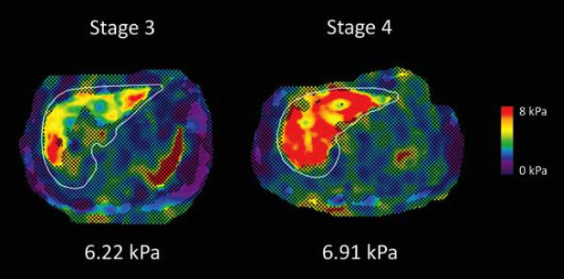
MRE elastography
Loomba, Hepatology 2014

Slide 22
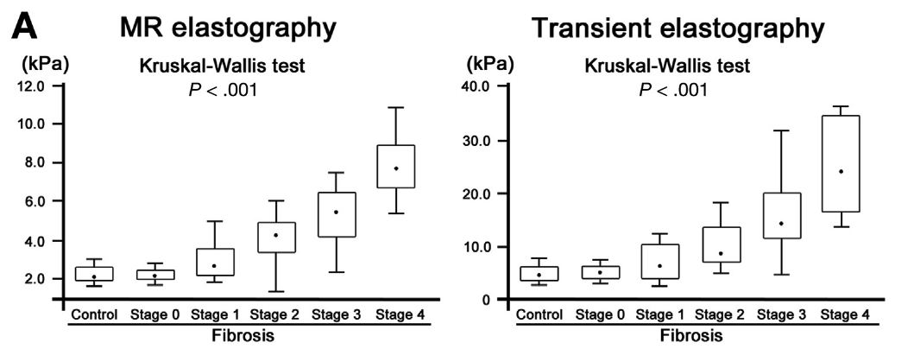
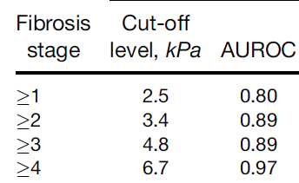
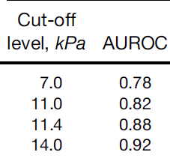
MRE elastography
MRE > TE for F>2 and for cirrhosis
Imajo, Gastroenterology 2016

Slide 23
Significantly Higher Diagnostic Accuracy With MRE vs TE for Fibrosis Staging in NAFLD
Overall (n =230) | AUROC | Optimal Threshold, kPa | Sensitivity, % | Specificity, % | PPV, % | NPV, % | P Value
Stage 1-4 (n = 157) vs 0 (n = 73)
MRE TE | 0.8685 0.8184 | 2.61 6.2 | 71.3 65.6 | 72.6 67.1 | 84.9 81.1 | 54.1 47.6 | .0394
Stage 2-4 (n = 93) vs 0-1 (n = 137)
MRE TE | 0.9193 0.8664 | 2.97 7.6 | 84.9 76.3 | 85.4 79.6 | 79.8 71.7 | 89.3 83.2 | .0265
Stage 3-4 (n = 57) vs 0-2 (n = 173)
MRE TE | 0.9295 0.8411 | 3.62 8.8 | 82.5 77.2 | 83.2 78.0 | 61.8 53.7 | 93.5 91.2 | .0004
Stage 4 (n = 25) vs 0-3 (n = 205)
MRE TE | 0.9423 0.8357 | 4.7 11.8 | 80.0 80.0 | 85.9 81.0 | 40.8 33.9 | 97.2 97.1 | .0046
Hsu C, et al. EASL 2018. Abstract FRI-439.

Slide 24
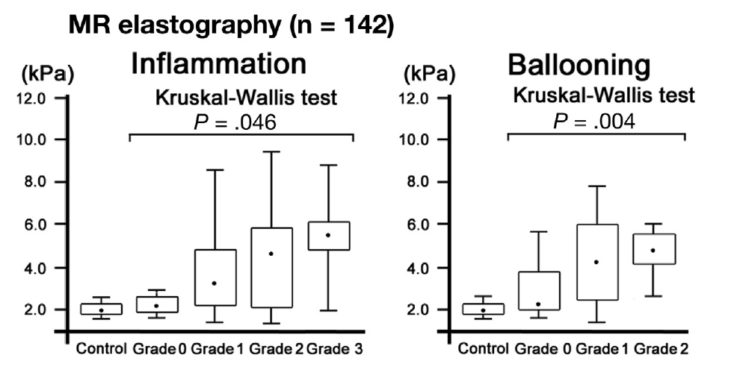
Confounders or MR elastometry values
Notes:
MRE goes up with inflammation

Slide 25
Hepamet Score Improves Noninvasive Classification of Fibrosis in Patients With NAFLD
Noninvasive panel to predict fibrosis stage developed in patients with biopsy-proven NAFLD
Spain, n = 758; France, n = 444; Cuba, n = 344; Italy, n = 288
36% significant fibrosis, 20% advanced fibrosis, 6% cirrhosis
Estimation in Spanish cohort, validation in remaining patients
Variables associated with advanced fibrosis: older age, female sex, T2DM, HOMA ≥ 4, AST ≥ 35 IU/mL, albumin < 4 g/dL, and PLT ≤ 220 x 10⁹
AUROC (N = 834) | Hepamet | NFS | FIB-4 | P Value
F2-F4 | 0.758 | 0.679 | 0.731 | .0001
F3-F4 | 0.847 | 0.767 | 0.797 | .0001
F4 | 0.902 | 0.863 | 0.875 | .0397
Compared with FIB-4 and NFS, Hepamet Fibrosis Score:
Improved classification of fibrosis in patients with NAFLD
Reduced proportion of patients falling in the grey zone
Avoided age-adjusted cutoffs
Ampuero J, et al. EASL 2018. Abstract PS-179.
Notes:
NFS, NAFLD Fibrosis Score.

Slide 26
PRO-C3 : a marker of fibrosis and fibrogenesis
Type III collagen synthesis is upregulated in liver fibrosis
Pro-C3 is a neo-epitope marker reflecting true type III collagen formation
Pro-C3 is able to predict progression of hepatitis C in patients at baseline over a 1-year period¹
Pro-C3 is a candidate marker for identifying the fibrotic subpopulation of patients with NAFLDª
Intact
C3-ab
C3M
Pro-C3-ab
Procollagen
Pro-C3
PIIINP-ab
PIIINP
ªPredefined cut-off points for evaluation of the diagnostic value of Pro-C3 were defined by the optimal diagnostic ability of Pro-C3² and cut-off for being a fast progressor in two different cohorts of patients with hepatitis C¹
1. Nielsen MJ et al. Liver Int 2015;35:429–37
2. Nielsen MJ et al. Am J Transl Res 2013;5:303–15

Slide 27
Pro-C3 is able to separate between fibrosis stages and NAFL from NASH
100
***
100
***
100
***
80
80
80
60
60
60
Pro-C3 (ng/mL)
Pro-C3 (ng/mL)
Pro-C3 (ng/mL)
40
40
40
20
20
20
0
0
0
F0–1
F2–4
F0–2
F3–4
NAFL
NASH
Fibrosis stage
Fibrosis stage
ROC curve of NASH CRN fibrosis ≥2
ROC curve of NASH CRN fibrosis ≥3
ROC curve for detecting NASH
100
100
100
80
80
80
60
60
60
Sensitivity (%)
Sensitivity (%)
Sensitivity (%)
40
40
40
20
AUROC 0.71
20
AUROC 0.73
20
AUROC 0.73
0
0
0
0
20
40
60
80
100
0
20
40
60
80
100
0
20
40
60
80
100
100% – Specificity (%)
100% – Specificity (%)
100% – Specificity (%)
AUC, area under the curve; NASH CRN, Nonalcoholic Steatohepatitis Clinical Research Network; NPV, negative predictive value; PPV, positive predictive value; ROC, receiver operating characteristic; SD, standard deviation
Box-and-whisker plots are shown as Tukey box plots; ªCut-off generated from Farglitazar cohort (HCV): Nielsen MJ et al. Liver Int 2015;35:429–37; ^{b}Cut-off generated from an Australian cohort (HCV): Nielsen MJ et al. PLoS One 2015;10:e0137302

Slide 28
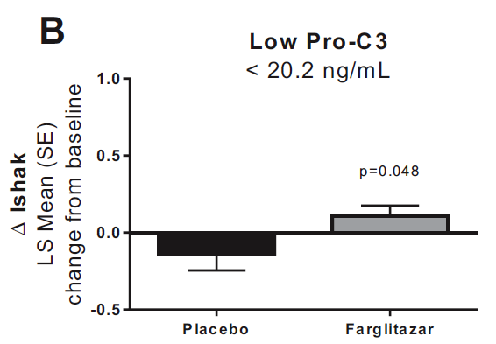
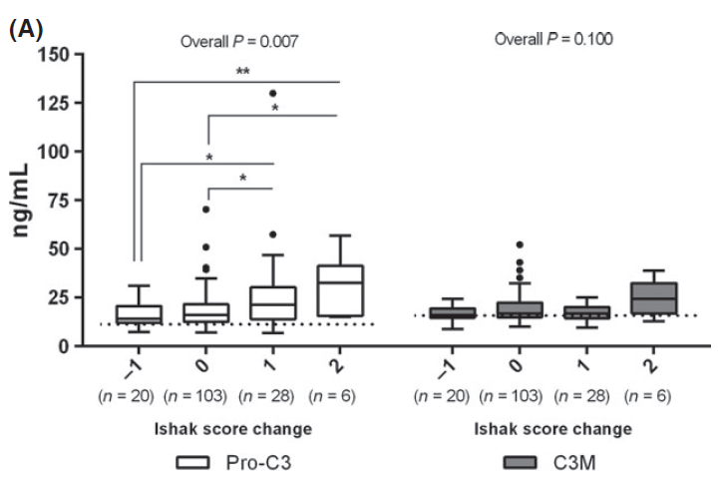
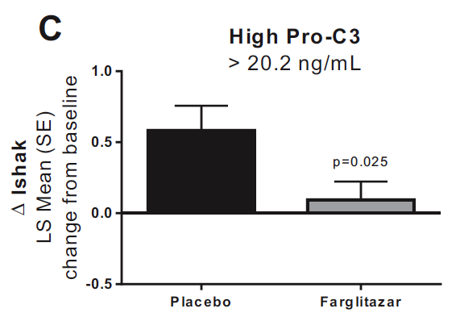
Pro-C3 levels are associated with increasing fibrosis and response to antifibrotic drugs
Karsdal, AmJ Physiol 2016
Nielsen, Liver Int 2014
Notes:
Changes in Ishak stage as a function of therapy and baseline pro-C3 levels. The ones >20.3 are called high risk patients

Slide 29
Two conceptual approaches to screening
Favor the exclusion of patients at very low risk of advanced disease
Favor the identification of some of the patients in need for therapy
Healthy
NAFLD
CIRRHOSIS
No NASH
NASH
NO
TO BE TREATED
Steatosis ≥1
Ballooning ≥1
Inflammation ≥1
NAS ≥ 4
F2 or higher
Patients at risk for progression to clinical events
Courtesy R Hanf, Genfit

Slide 30
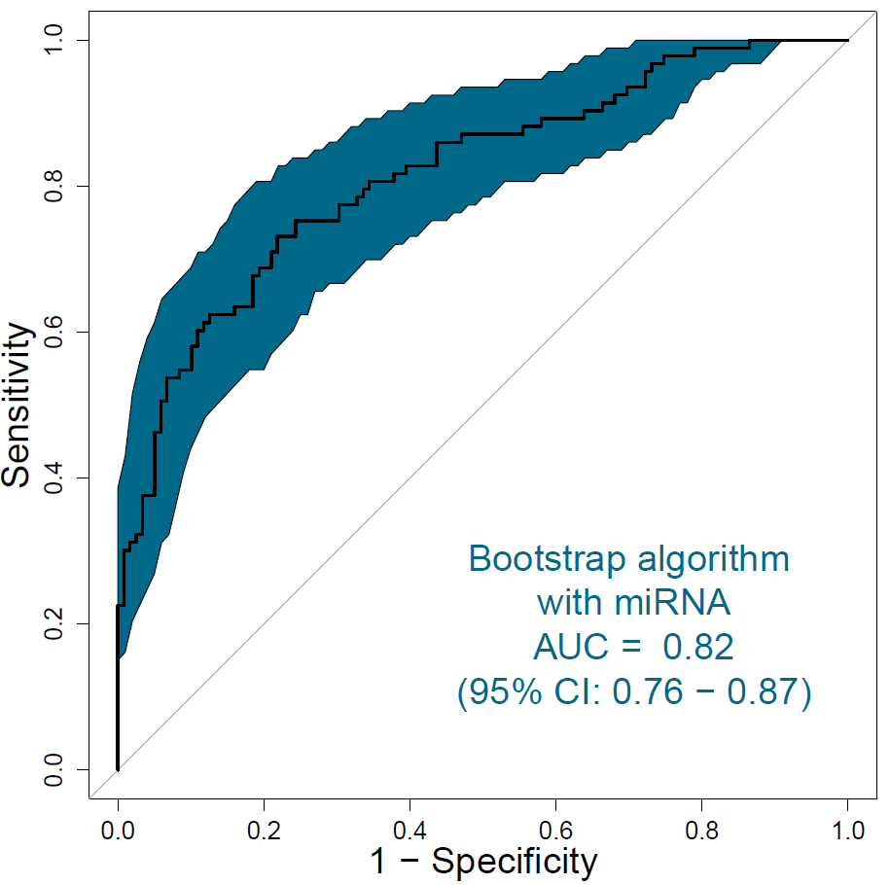
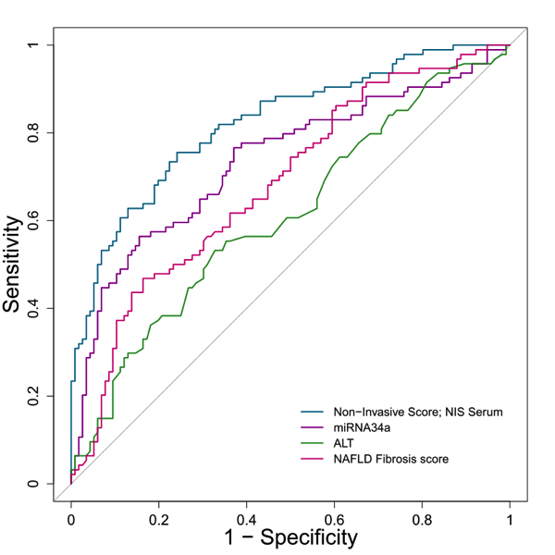
Biomarker signature for patients “to be treated”
To-be-Treated (NAS≥4, F≥2) vs. Not-To-Be –Treated (NAS<4, F<2)
NIS4 includes: miR34a, Alpha2-macroglobulin, CH3L1 (YKL40) and HbA1C
miR34a
NIS4
ALT
NALFD-Fibrosis Score
Courtesy R Hanf, Genfit

Slide 31
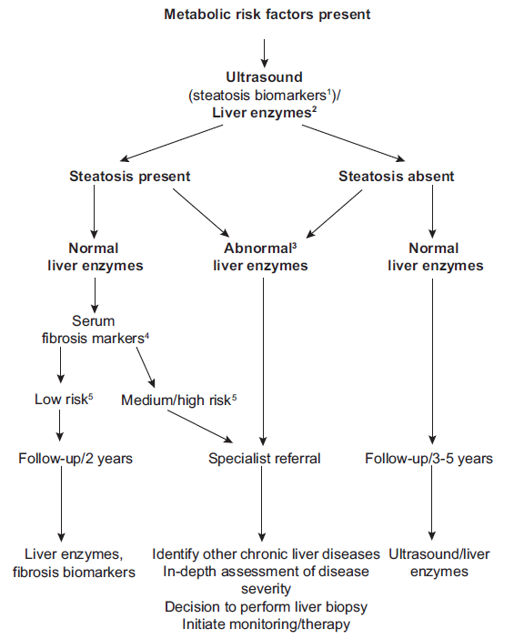

Slide 32
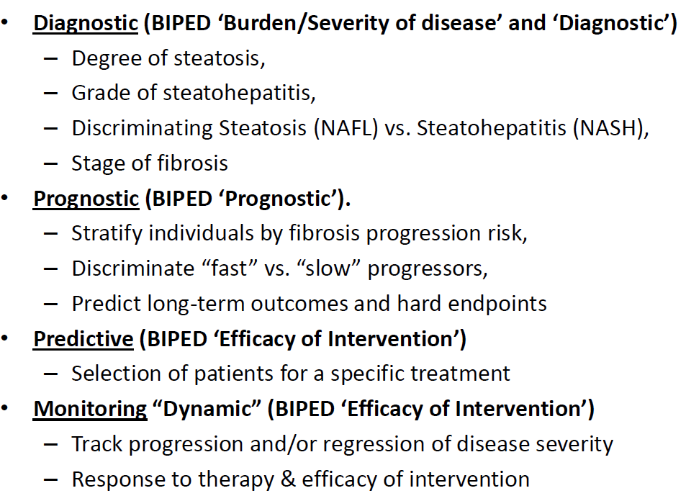
Future uses of Biomarkers

Slide 34
